Slide 1
Case-study part 2
Jason Kirkcaldy

Slide 2
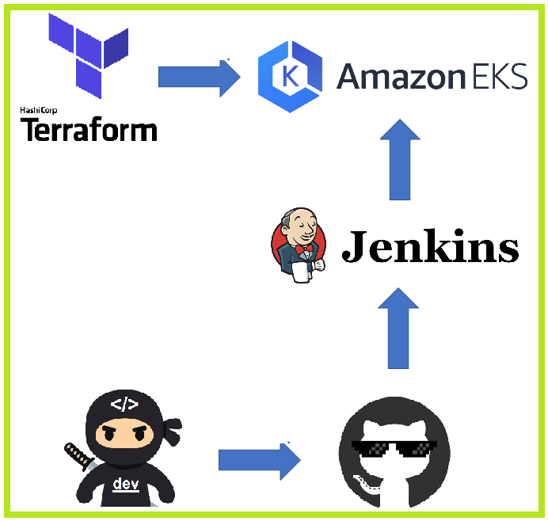
Design
Goals:
Use Terraform to deploy a Kubernetes cluster on AWS EKS along with the supporting architecture.
Use Jenkins to automatically deploy new code to the EKS cluster.

Slide 3

Assets
Ubuntu VM1 on Virtualbox
Terraform to deploy resources onto AWS
AWS CLI
Ubuntu VM2 on Virtualbox
Jenkins Server for automating code deployment.
AWS
EKS Cluster with supporting VPC, Load balancer, EC2 worker nodes.
EKSCTL to communicate with EKS cluster

Slide 4
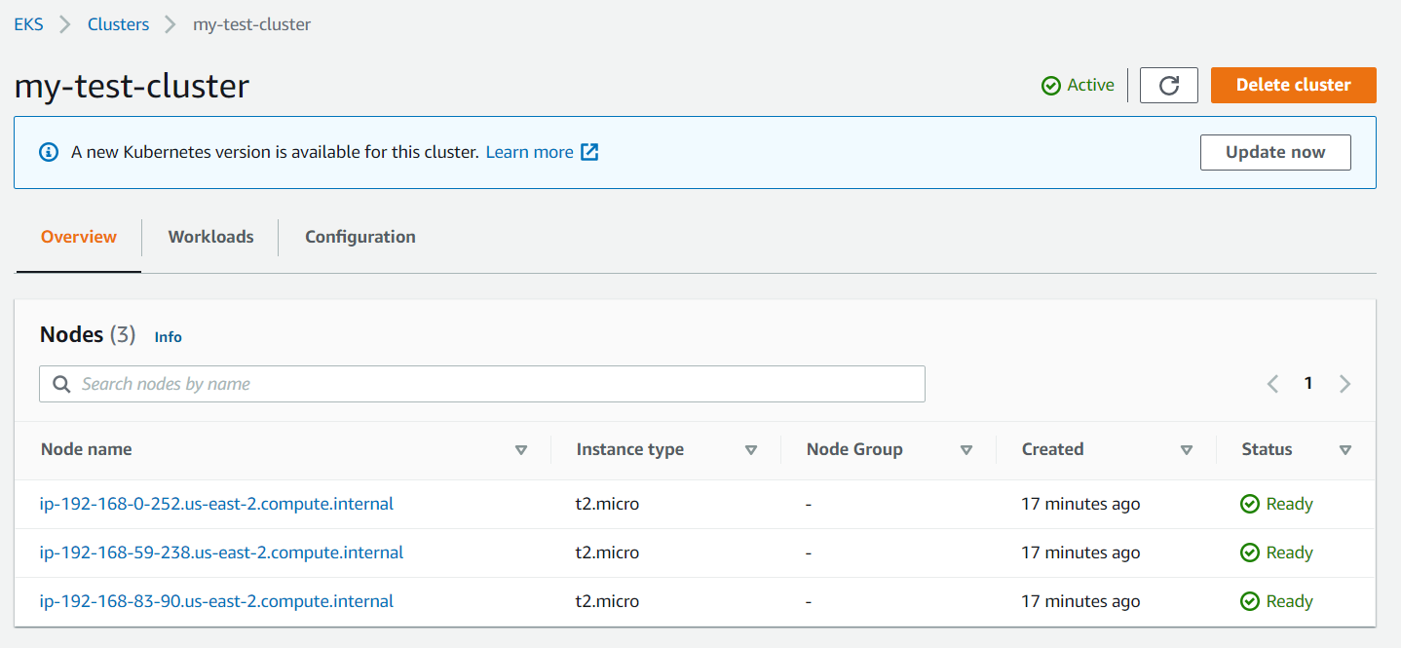
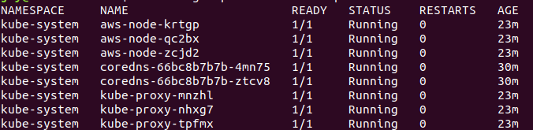
Steps – initial testing
Configure AWS CLI
Install EKSCTL
Create cluster.yaml file
Run test Kubernetes cluster on AWS EKS with the EKSCTL create cluster command.

Slide 5
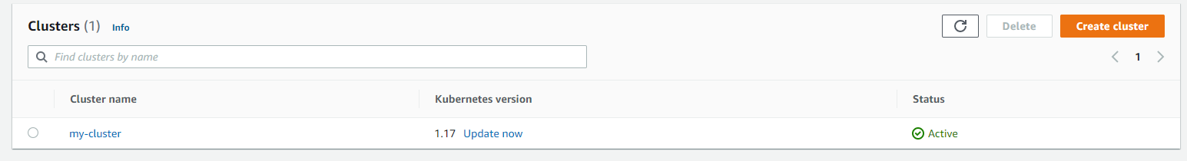
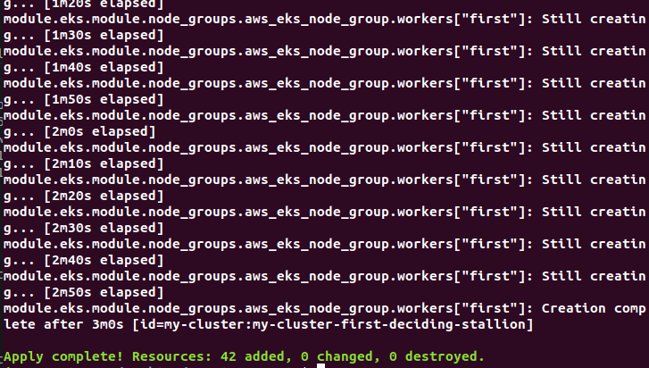
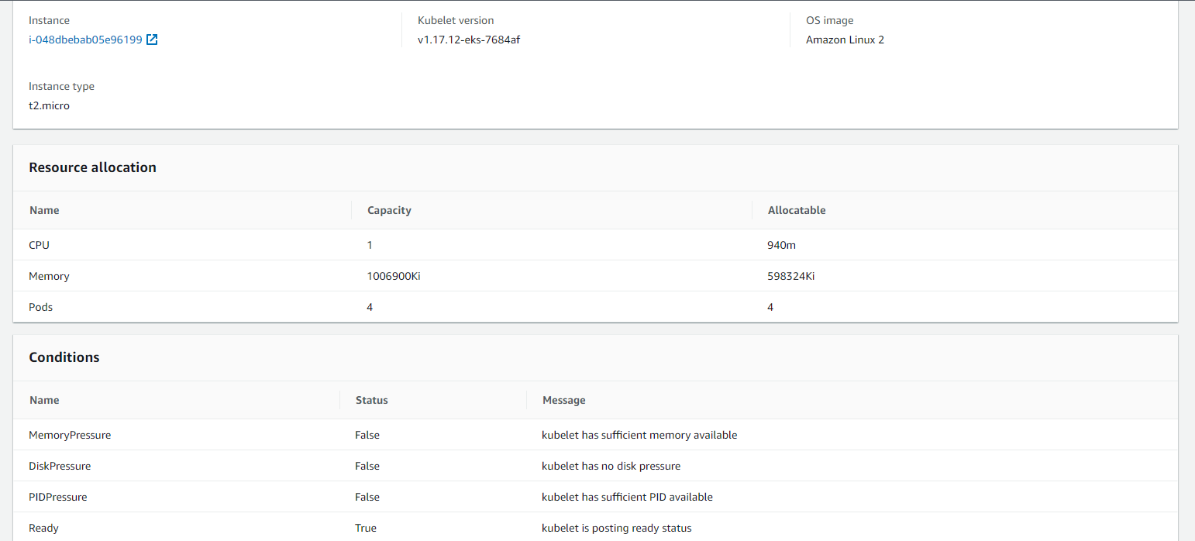
Steps – Deploy EKS cluster with Terraform
Create main.tf file with K8 specs
Run terraform init
Run terraform plan
Run terraform apply

Slide 6
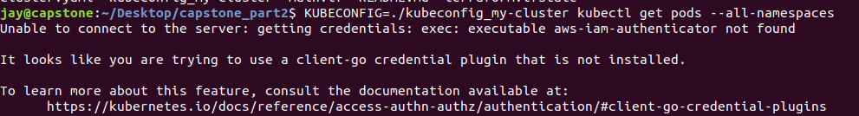
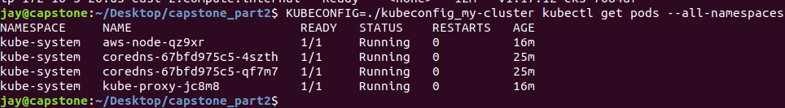
Steps – Deploy EKS cluster with Terraform - continued
An error received when trying to connect to deployed EKS cluster – solved by installing AWS-IAM-Authenticator on my VM.
These are the pods running on the EKS deployment.

Slide 7
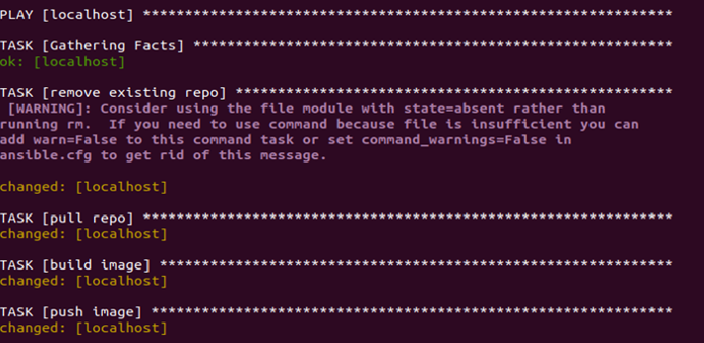
Steps – Configure Jenkins to run Ansible playbook
Create ansible playbook which will automatically pull the latest code for my app from github and then build and push a docker image to my dockerhub account.
Run the playbook through a Jenkins pipeline script whenever code changes are made

Slide 8
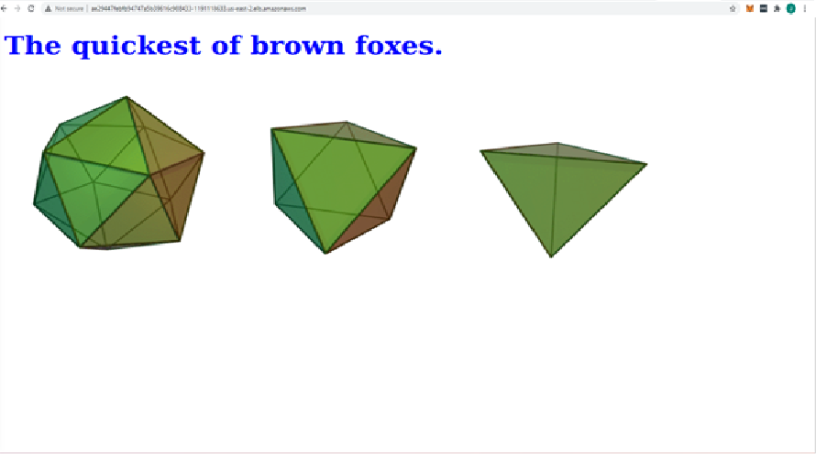
Steps – Deploy flask app onto the EKS cluster
Create deployment.yaml file that will pull the latest version of flask app from my Dockerhub repo- jasonautomation/case-study-part1
Run kubectl apply -f deployment.yaml
Create a loadbalancer.yaml file
Deploy the load balancer to AWS by running the kubectl apply –f command again.
Connect to the public IP of the load balancer to view the deployed application.
Whenever new code is deployed, I will rerun the kubectl appy –f deployment.yaml command to push the latest release of the docker image.

Slide 9
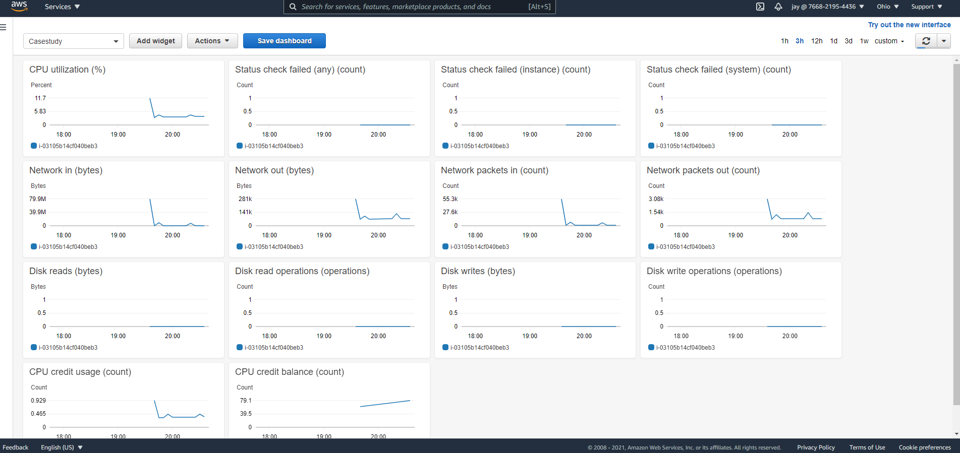
Monitoring
Set up a Cloudwatch metrics dashboard to monitor the EC2 instances that are using on my EKS cluster.

Slide 10
Sources
https://learnk8s.io/terraform-eks
https://github.com/JasonAutomation/2020_03_DO_Boston_casestudy_part_1
https://docs.aws.amazon.com/eks/latest/userguide/install-aws-iam-authenticator.html

